Slide 1

Residual Analysis

Slide 2
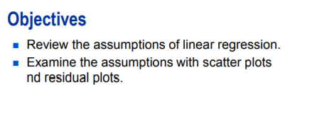
Residual Analysis

Slide 3
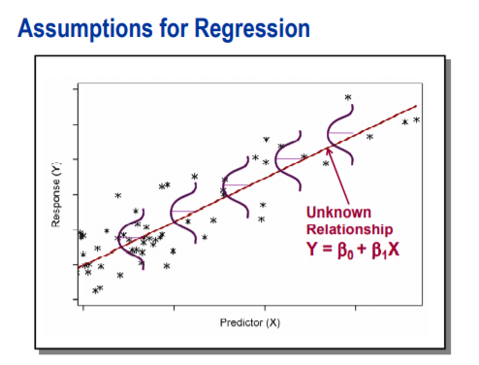
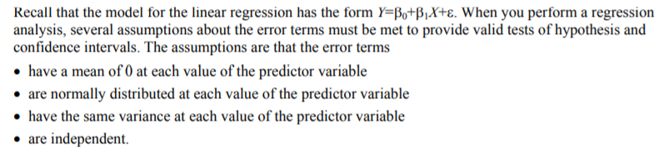
Residual Analysis

Slide 4
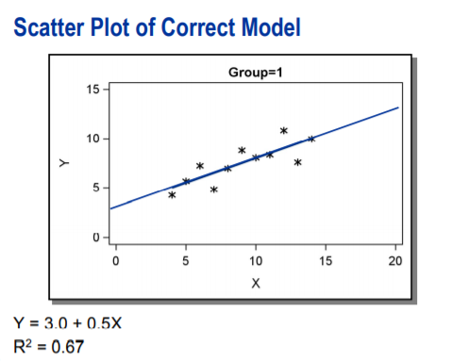
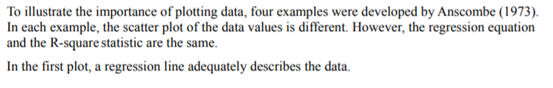
Residual Analysis

Slide 5
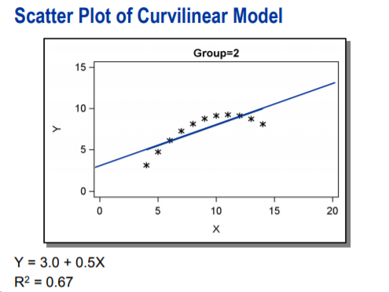
Residual Analysis

Slide 6
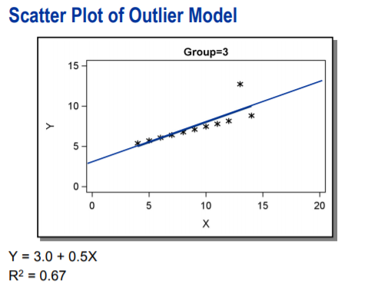
Residual Analysis

Slide 7
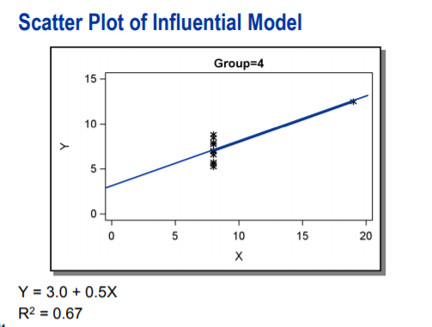
Residual Analysis
In the fourth plot, the outlying data point dramatically changes the fit of regression line. In fact, the slope would be undefined without the outlier.
The four plots illustrate that relying only on regression output to describe the relationship between your variables can be misleading. The regression equation and R-Square statistics are same even though the relationship is different between the variables.
Always produce the scatter plot before you perform the regression analysis.

Slide 8
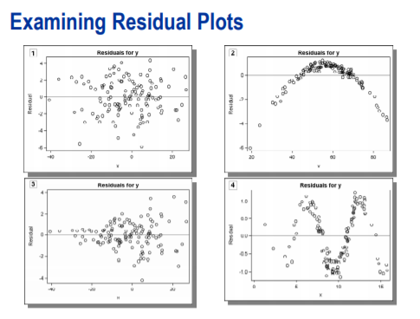
Residual Analysis

Slide 9

DEMO

Slide 10
Q&A

